Slide 1
What is an example of a “World Religion”?
What makes something a “World Religion”?
What makes a “World Religion” different from another way of organizing people into groups (for example, a country)?

Slide 2
WELCOME TO RLST 100!
OVERVIEW OF THE COURSE

Slide 3
Welcome!
First university class ever?? YAY!
First Religious Studies class? Also yay!
New To Regina?
New to Canada?
New to North America?

Slide 4
Welcome (again!)
Excited? (me too!)
Anxious? (me too!)
Indifferent? (we’ll fix that!)
Learning vs. Grading

Slide 5
Support (Official)
Writing Services
https://www.uregina.ca/student/ssc/tutoring/writing-support/index.html
Centre for Student Accessibility
https://www.uregina.ca/student/accessibility/index.html

Slide 6
Support (Unofficial)
Your fellow students
Me!

Slide 7
Our Classroom
No cell phones!!!
Bring discussions forward in the form of questions or comments
Laptops and tablets are permitted, but using them for anything but notetaking or readings will result in me asking you to leave

Slide 8
Taking Notes
All slides are posted on URCourses after class
No need to write them out
Listen for ideas, not simply “facts”
Taking notes by hand slows you down and allows you to actually listen rather than simply copy down slides or transcribe the discussion

Slide 9
Lectures
Lectures will begin at 12:130 sharp
The content of the lecture is not identical to the readings

Slide 10
Preparing for Lectures
The readings will frame the questions we discuss and outline the major ideas we tackle, but lectures will not repeat the readings (so make sure you know them before class starts!)
The readings can be difficult and will likely need to be read at least twice

Slide 11
In Lecture
I can talk forever, but that’s boring
Come to lecture prepared with questions, comments, and a keenness for discussion
There will be plenty of time for small discussions, larger group discussions, and classroom discussions
Please ensure you are always respectful of your fellow student and don’t speak over anyone, and always keep your tone civil

Slide 12
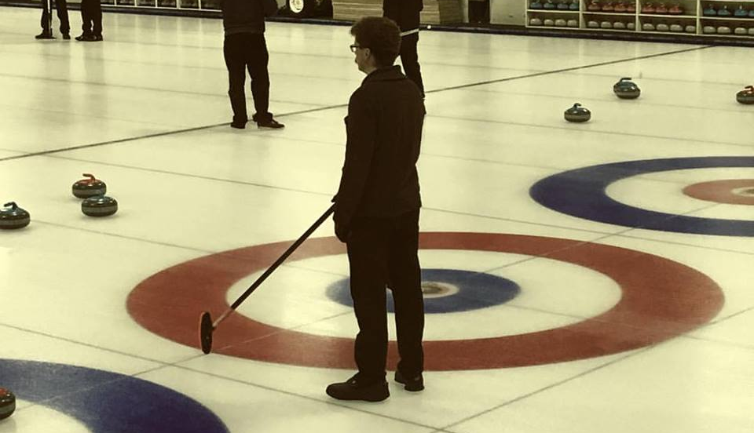
Me

Slide 13
But when I’m not curling
Ian Phillip Brown
Office: CL 224
Email: ian.brown@uregina.ca
Office Hours:
Mondays and Fridays 2:30-4pm
First-come, first served
You can also make an appointment over email

Slide 14
Syllabus
Please Read It!

Slide 15
URCourses
URCources (URC) will host all additional course material and instructions
Additional readings
Assignment instructions and rubrics
Discussion board
PowerPoint
Please submit all assignments through the assignment section of URC AS WELL AS through Turn It In (TII)

Slide 16
Assignments
Must be submitted to BOTH URC AND TII
Must be submitted by 11:59pm
Late penalty 5% per day
Do not email me your assignment

Slide 17
Email Policy
Be polite and professional
“Dear Ian” or “Dear Mr. Brown”
NOT “hey prof”
Check syllabus first
Send emails from your U of R account
Allow 1-2 business days for a reply

Slide 18
Academic Misconduct
It is your responsibility to familiarize yourself with the definition of Academic Misconduct in the Undergraduate Calendar (see link in syllabus)

Slide 19
Schedule
We will follow the syllabus unless otherwise noted
Each class has a topic and reading associated with it
Please note that Dr. Yuan Ren will be lecturing on Confucianism, Daoism, and the first two classes on Hinduism

Slide 20
Required Texts
Introduction to Religious Studies (fifth edition), edited by Kevin Bond
Available for purchase in the bookstore
All other readings will be posted to URC

Slide 21
Grading
Based on performance, not a curve
Everyone starts at 0 and earns grades
My expectations are laid out clearly in assignment instructions and grading rubrics

Slide 22
Grading: Nuts and Bolts
Quizzes 20%
Field Research Assignment 40%
More in this in a second
Final Exam 40%

